Slide 1
Non-regular languages
(Pumping Lemma)

Slide 2
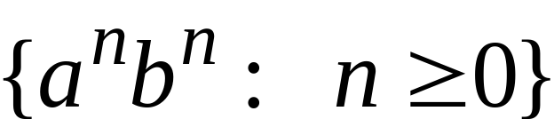
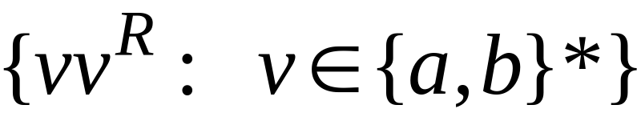


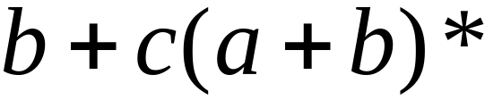

Non-regular languages
Regular languages

Slide 3

How can we prove that a language
is not regular?
Prove that there is no DFA or NFA or RE
that accepts
Difficulty: this is not easy to prove
(since there is an infinite number of them)
Solution: use the Pumping Lemma !!!

Slide 4

The Pigeonhole Principle

Slide 5


pigeons
pigeonholes

Slide 6
A pigeonhole must
contain at least two pigeons

Slide 7



pigeons
...........
pigeonholes
...........

Slide 8
The Pigeonhole Principle
pigeons
pigeonholes
There is a pigeonhole
with at least 2 pigeons
...........

Slide 9
The Pigeonhole Principle and
DFAs

Slide 10






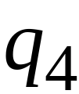


Consider a DFA with states

Slide 11




Consider the walk of a “long’’ string:
(length at least 4)
A state is repeated in the walk of

Slide 12
The state is repeated as a result of
the pigeonhole principle
Walk of
Pigeons:
(walk states)
Are more than
Nests:
(Automaton states)
Repeated
state

Slide 13

Consider the walk of a “long’’ string:
(length at least 4)
Due to the pigeonhole principle:
A state is repeated in the walk of

Slide 14
The state is repeated as a result of
the pigeonhole principle
Walk of
Pigeons:
(walk states)
Are more than
Nests:
(Automaton states)
Automaton States
Repeated
state

Slide 15
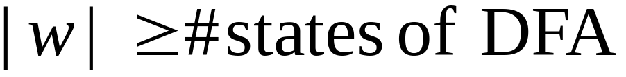

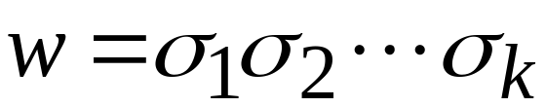












In General:
If ,
by the pigeonhole principle,
a state is repeated in the walk
Walk of
....
....
....
Arbitrary DFA
......
......
Repeated state

Slide 16
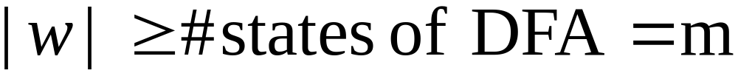

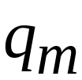

Walk of
Pigeons:
(walk states)
....
....
....
Are
more
than
....
....
Nests:
(Automaton states)
A state is
repeated

Slide 17
The Pumping Lemma

Slide 18
Pumping Lemma
The term Pumping Lemma is made up of two words:
Pumping: The word pumping refers to generate many input strings by pushing a symbol in an input string again and again.
Lemma: The word Lemma refers to intermediate theorem in a proof.

Slide 19
Pumping Lemma
Pumping Lemma is used to prove that given language is not regular.
So, first of all we need to know when a language is called regular.
A language is called regular if:
  Language is accepted by finite automata.
  A regular grammar can be constructed to exactly generate the strings in a language.
  A regular expression can be constructed to exactly generate the strings in a language.

Slide 20
Pumping Lemma
First technique to show that specific given languages are not regular.
The idea:
  Each regular language satisfies the pumping lemma, →so, if a language does not, then, it is non-regular!

Slide 21

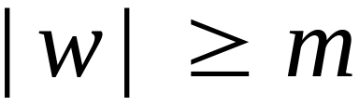
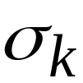

Take string with
(number of
states of DFA)
then, at least one state is repeated
in the walk of
Walk in DFA of
......
......
Repeated state in DFA

Slide 22

There could be many states repeated
Take to be the first state repeated
One dimensional projection of walk :
First
occurrence
Second
occurrence
....
....
....
Unique states

Slide 23


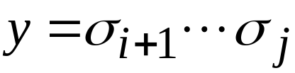
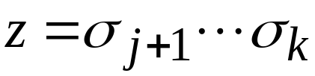
We can write
One dimensional projection of walk :
First
occurrence
Second
occurrence
....
....
....

Slide 24





In DFA:
contains only
first occurrence of
...
...
...
...

Slide 25


Observation:
length
number
of states
of DFA
...
Unique States
...
Since, in no
state is repeated
(except q)

Slide 26

Observation:
length
Since there is at least one transition in loop
...

Slide 27
We do not care about the form of string
may actually overlap with the paths of and
...
...

Slide 28

Additional string:
The string
is accepted
Do not follow loop
...
...
...
...

Slide 29

Additional string:
The string
is accepted
Follow loop
2 times
...
...
...
...

Slide 30

Additional string:
The string
is accepted
Follow loop
3 times
...
...
...
...

Slide 31
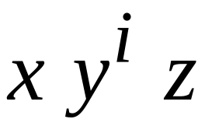


In General:
The string
is accepted
Follow loop
times
...
...
...
...

Slide 32
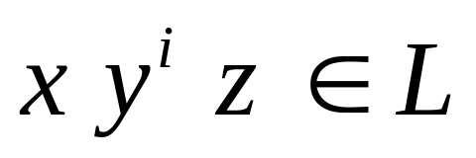
Therefore:
Language accepted by the DFA
...
...
...
...

Slide 33
In other words, we described:
The Pumping Lemma !!!

Slide 34


The Pumping Lemma:
Given a infinite regular language
there exists an integer
(critical length)
for any string with length
we can write
with and
Or |y| > 0
such that:

Slide 35
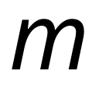
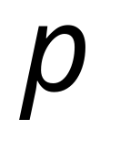
In the book:
Critical length = Pumping length

Slide 36
Applications of the Pumping Lemma

Slide 37
Observation:
Every language of finite size has to be regular
(we can easily construct an NFA
that accepts every string in the language)
Therefore, every non-regular language
has to be of infinite size
(contains an infinite number of strings)

Slide 38

Suppose you want to prove that
An infinite language is not regular
1. Assume the opposite: is regular
2. The pumping lemma should hold for
3. Use the pumping lemma to obtain a
contradiction
4. Therefore, is not regular

Slide 39


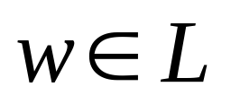
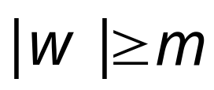
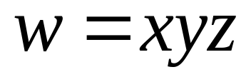
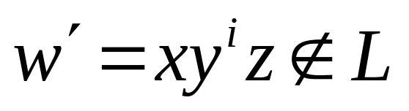
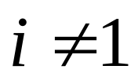
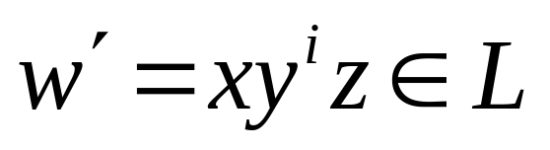
Explanation of Step 3: How to get a contradiction
1. Let be the critical length for
2. Choose a particular string which satisfies
the length condition
3. Write
4. Show that
for some
5. This gives a contradiction, since from
pumping lemma

Slide 40

Note:
It suffices to show that
only one string
gives a contradiction
You don’t need to obtain
contradiction for every

Slide 41

Example of Pumping Lemma application
Theorem:
The language
is not regular
Proof:
Use the Pumping Lemma

Slide 42
Assume for contradiction
that is a regular language
Since is infinite
we can apply the Pumping Lemma

Slide 43


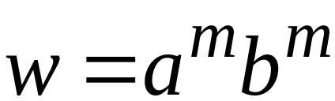
Let be the critical length for
Pick a string such that:
and length
We pick

Slide 44
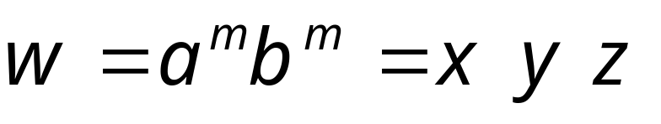

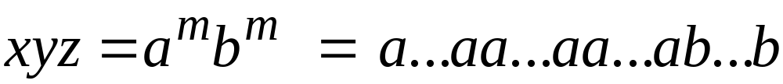

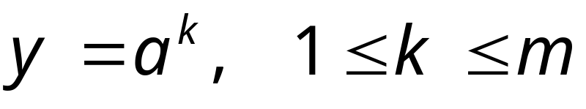
From the Pumping Lemma:
we can write
with lengths
Thus:

Slide 45
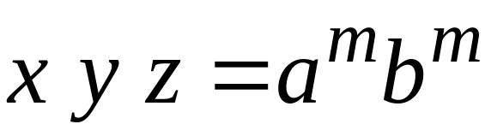

From the Pumping Lemma:
Thus:

Slide 46

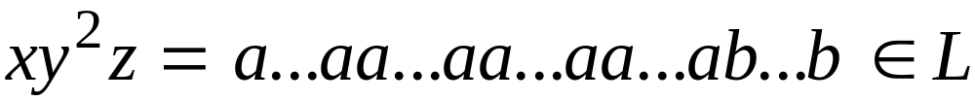
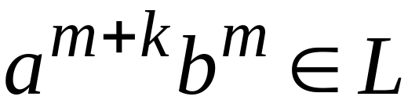
From the Pumping Lemma:
Thus:

Slide 47
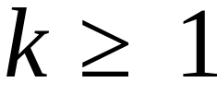
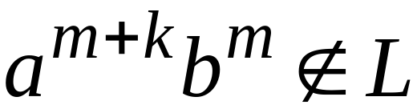
BUT:
CONTRADICTION!!!

Slide 48
Therefore:
Our assumption that
is a regular language is not true
Conclusion:
is not a regular language
END OF PROOF

Slide 49
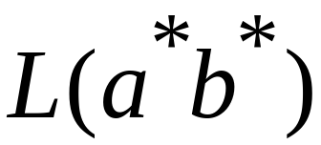
Non-regular language
Regular languages

Slide 50
Application of Pumping Lemma
Example 1: A = { 0^{n}1^{n} | n ≥ 0} is not regular.
Proof. By contradiction. Assume, on the contrary, that A is regular.
Then the pumping lemma holds for A. Let p be a pumping length.
Let w = 0^{p}1^{p}. Then w is in A and is longer than p. Then by pumping
Lemma, w can be divided into w=xyz such that
    For each i ≥ 0, xy^{i}z ∈ A
    |y| > 0, and 00000000 11111111
    |xy| ≤ p.
Then x and y are all 0’s. So, xyyz has more 0’s than 1’s and is in A.
A contradiction. So, A is not regular.
y

Slide 51
Application of Pumping Lemma
1 1 0 0 1 1 0 0
Example 3: C = {ww | w ∈{0,1}*} is not regular.
0101, 001001
Proof. By contradiction. Assume, on the contrary, that C is regular.
Then the pumping lemma holds for C. Let p be a pumping length.
Let w = 0^{p}10^{p}1. Then w is in C and is longer than p. Then by pumping
Lemma, w can be divided into w=xyz such that
  For each i ≥ 0, xy^{i}z ∈ C
  |y| > 0, and 001001
  |xy| ≤ p.
Then x and y are all 0’s. Obviously xyyz cannot be represented as ww.
A contradiction to that xyyz ∈ C. So, C is not regular.
y

